Slide 1
Individual homework
Resolution in propositional logic
Exercise 6.2
Using lock resolution prove the inconsistency of the following set of clauses.
Choose two different indexings for the literals:
S2 = { q ∨ ¬r, ¬q ∨ ¬p ∨ ¬r, ¬q ∨ p ∨ ¬r, r }
Creț Valentina Andreea
Group 912

Slide 2
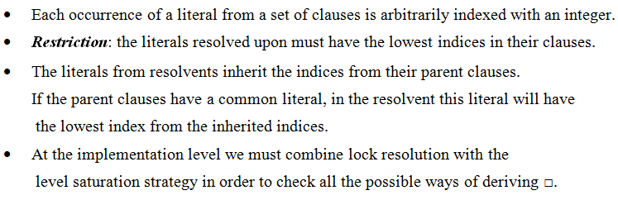
Lock Resolution
THEORETICAL RESULTS

Slide 3
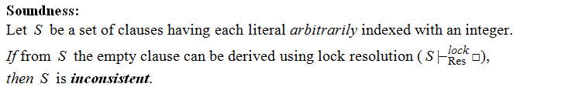
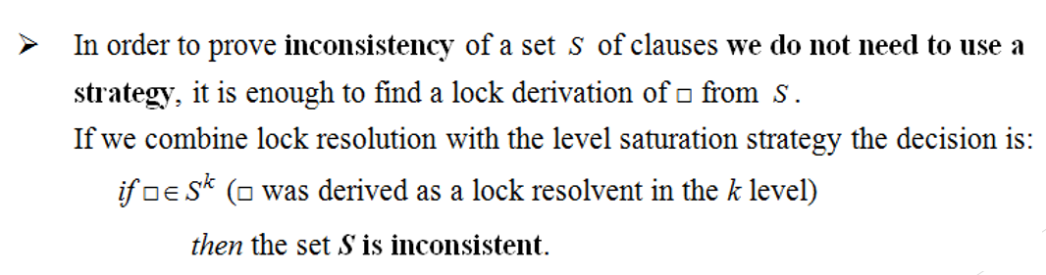
Lock Resolution - Theorems
Remark:

Slide 4
Method 1:
C₁ C₂ C₃ C₄
S₂ = { q ∨ ¬r, ¬q ∨ ¬p ∨ ¬r, ¬q ∨ p ∨ ¬r, r }
(2) (1) (3) (5) (4) (7) (6) (8) (9)
C₁ = q ∨ ¬r
C₂ = ¬q ∨ ¬p ∨ ¬r
C₃ = ¬q ∨ p ∨ ¬r
C₄ = r
C₆ = Res_{q}^{lock} (C_{2,} C₅) = ¬p ∨ ¬r
(2) (1)
(5) (4)
C₇ = Res_{r}^{lock} (C_{4,} C₆) = ¬p
(3) (5) (4)
(5)
C₈ = Res_{p}^{lock} (C_{3,} C₇) = ¬q ∨ ¬r
(7) (6) (8)
(7) (8)
C₉ = Res_{q}^{lock} (C_{5,} C₈) = ¬r
(9)
(8)
C₅ = Res_{r}^{lock} (C_{1,} C₄) = q
C₁₀ = Res_{r}^{lock} (C_{4,} C₉) = ◻
(2)

Slide 5
Method 2:
C₁ C₂ C₃ C₄
S₂ = { q ∨ ¬r, ¬q ∨ ¬p ∨ ¬r, ¬q ∨ p ∨ ¬r, r }
(2) (1) (5) (3) (4) (6) (8) (7) (9)
C₁ = q ∨ ¬r
C₂ = ¬q ∨ ¬p ∨ ¬r
C₃ = ¬q ∨ p ∨ ¬r
C₄ = r
C₆ = Res_{q}^{lock} (C_{3,} C₅) = p ∨ ¬r
(2) (1)
(8) (7)
C₇ = Res_{r}^{lock} (C_{4,} C₆) = p
(5) (3) (4)
(8)
C₈ = Res_{p}^{lock} (C_{2,} C₇) = ¬q ∨ ¬r
(6) (8) (7)
(5) (4)
C₉ = Res_{r}^{lock} (C_{4,} C₈) = ¬q
(9)
(5)
C₅ = Res_{r}^{lock} (C_{1,} C₄) = q
C₁₀ = Res_{q}^{lock} (C_{5,} C₉) = ◻
(2)

Slide 6
Conclusion:
S₂ ⊢ ^{lock}_{Res} ◻ => S₂ is inconsistent

